Slide 1

Mini Project - 02
Store Sales prediction

Slide 2
Store Sales Prediction
Agenda
Business Oriented Analysis
Technical Analysis

Slide 3
Store Sales Prediction
Business Oriented Analysis

Slide 4
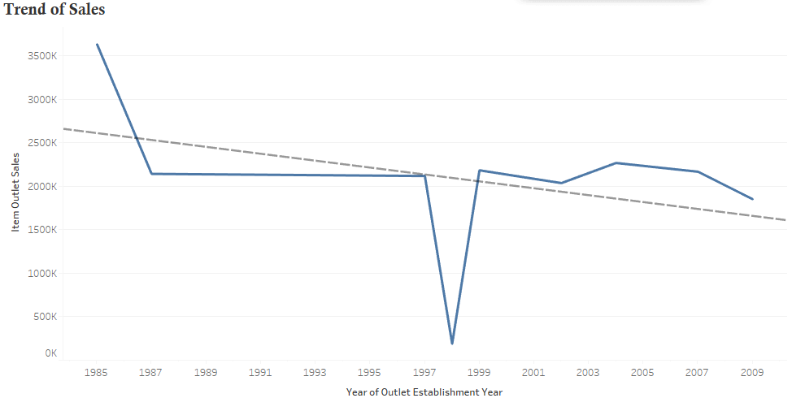
Store Sales Prediction
There is a down trend in total Sales of Store

Slide 5
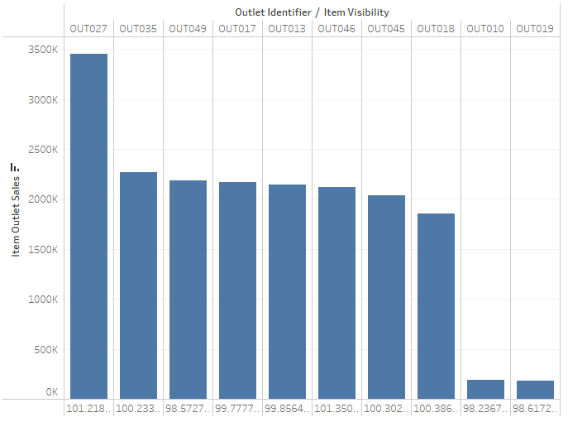
Store Sales Prediction
Except OUT010 and OUT019 Outlet , all other outlet is has good potential

Slide 6
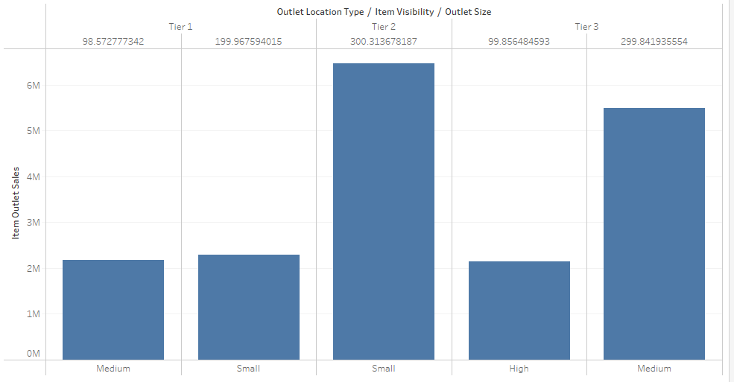
Store Sales Prediction
Except OUT010 and OUT019 Outlet , all other outlet is has good potential

Slide 7
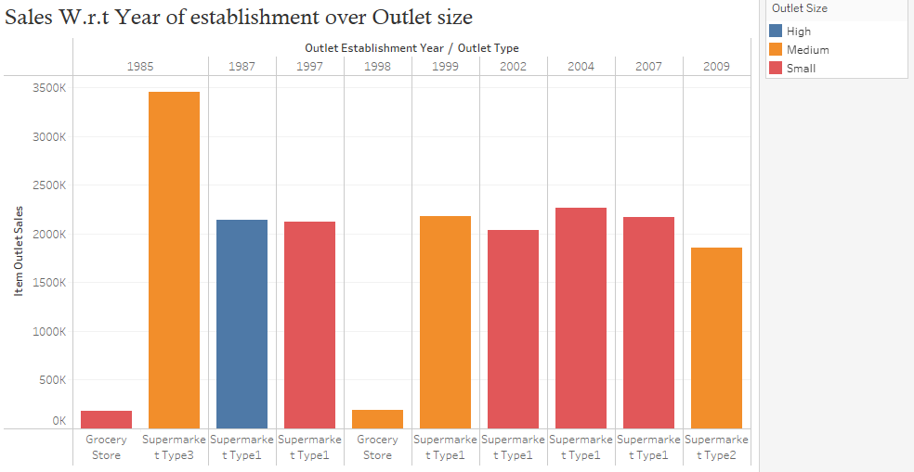
Store Sales Prediction
By looking at Trend of Outlet Type and Outlet Size Over the Year , Suggestion is to Focus more on Small and medium size Supermarket of all the type

Slide 8
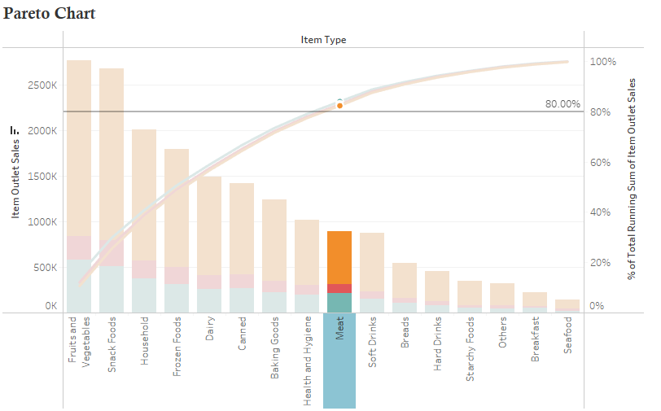
Store Sales Prediction
Vital
Trivial
The Pareto principle (also known as the 80/20 rule) is a phenomenon that states that roughly 80% of outcomes come from 20% of causes.

Slide 9
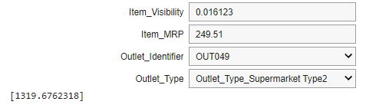
Store Sales Prediction
Using user interaction , Any employee can predict the Sales.

Slide 10
Suggestion
Improve the item visibility of Outlet10 and Outlet19 in Tier1 and Tier3 locations.
Focus on improving regular fat-content products and boosting low fat-content products by increasing item visibility.
Being particular with a product to be focused more on are as follows:
Fruits and vegetables
Snack food
House hold
Frozen foods
Dairy
Canned
Booking Goods
Health and Hygiene.
Meat.

Slide 11
Store Sales Prediction
Technical Oriented

Slide 12
Store Sales Prediction
Dropped Rows that had Missing values in Target column .
Feature Selection and Feature Transformation.
Algorithm’s used to Build models in order to predict ‘Store Sales Data’ are mentioned below :
Linear Regression > Because As it is Statistically based basic model.
Decision Tree Regressor > Because there was under fitting of Linear Regression.
Stacking Regressor > To improve its performance than Decision Tree Regressor.
Multi Layer Stacking Regressor > To improve its performance than Stacking Regressor

Slide 13
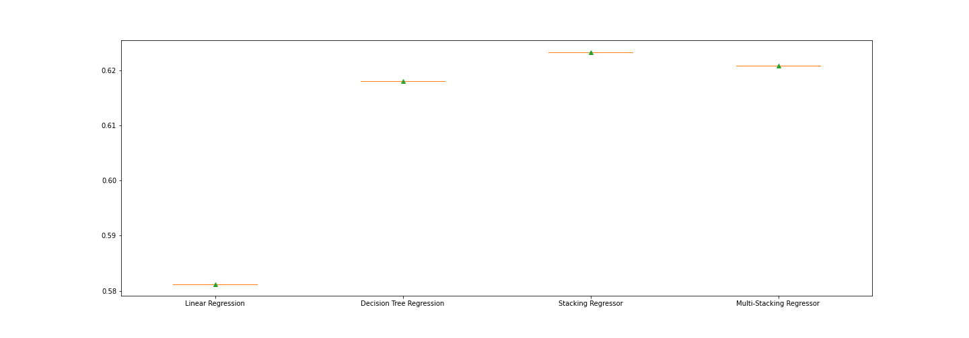
Store Sales Prediction Model Comparison

Slide 14
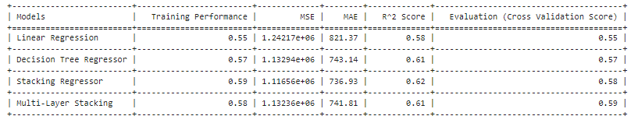
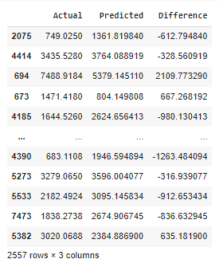
Store Sales Prediction

Slide 15
Store Sales Prediction
Stacking Regressor
Base Model :
1) AdaBoost Regressor > Lower’s the Bias
2) Random Forest Regressor > Lower’s the Variance
Meta Model :
1) Linear Regression > Since input will be generalized So no, heavy algorithm is required.

Slide 16
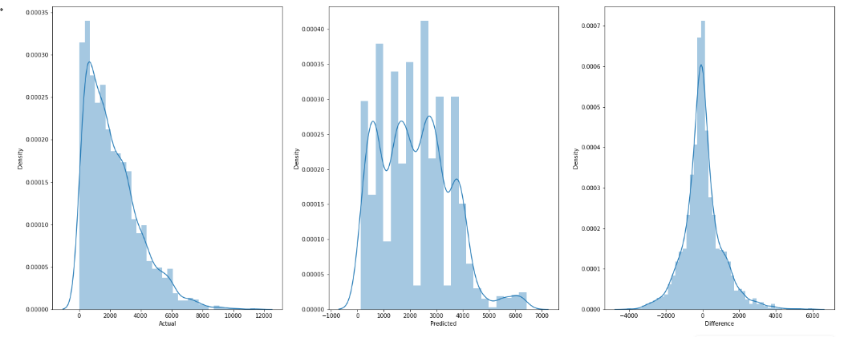
Store Sales Prediction

Slide 17
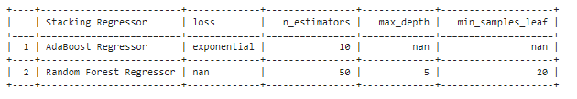
Store Sales Prediction - Salient Features of base model
Interpretation
Stacking Regressor is performing Well than other model as Highest R^2 Score and less Residual errors.
Hyper parameter used for Base Model of stacking is tabulated above.
Performance of Multiple Layer Stacking can be increased, if we increase more Hidden layes in Multiple Stacking Classifiers and by doing Hyper parameter tuning over activation optimizers and loss function.
Click here to see out put Splits csv\test^pred.xlsx
Click here to see workbook

Slide 18








Thank You

